Slide 1
Link : csci5308vm5.research.cs.dal.ca:5173
Team 5
Bid4Good
Amanjot Singh
Kush Sutaria
Jill Pujara
Harsh Srivastava
Darshil Patel
A LIVE AUCTION PLATFORM

Slide 2
Summary
The website is an online platform for auctions and marketplace sales.
Verified sellers can create two types of auctions:
Live auctions, where buyers can place bids in real-time as the auction progresses.
Blind auctions, where buyers submit sealed bids and the highest bidder wins.
Buyers can participate in auctions by placing bids or making purchases in the marketplace.
The website has an admin system to verify sellers based on their provided ID.

Slide 3
Task Contribution
Name | Tasks completed
Amanjot Singh | 25
Darshil Patel | 25
Harshil Srivastav | 34
Jill Pujara | 20
Kush Sutaria | 33

Slide 4
Individual Task
Team member | Features implemented/contributed
Amanjot Singh | User Registration , Backend Architecture,Database Archietcture, Report Isssues,Wishlist, Adding Orders,Order History, Testing including unit testing and Integration Testing,Project Documentation
Darshil Patel | DB integration,Axios Forntend-backend Connection, Session , secure routing at backend, cors security implementation,Continous Deployment, Live auction with sockets, live auction details API, VM Configuration, automation scripts .sh for CD at backend.
Harsh Srivastava | UI architecture , Live bid FE BE, Blind Bid, Simple Sell, Timer, Admin Dashboard(BE,FE), Buyer Details Page
Darshil Patel | API for adding bid items, placing bids, fetching timer, Database Architecture, fetching details and logic|| api for generating winner of the bid
Kush Sutaria | CI, Code quality, Wishlist, homepage, UI, homepage, filter, bugs, Report Issues, Input Validation, CD gitlab handshake Admin issue details

Slide 5
Project Status
Goals | Status
Features | Completed
CI/CD/Code Quality | Completed
Code smells | Completed
Learning a new tech stack | Completed
Improved UI (mid term review) | Completed
QR code verification process | Dropped After Discussion with Client

Slide 6
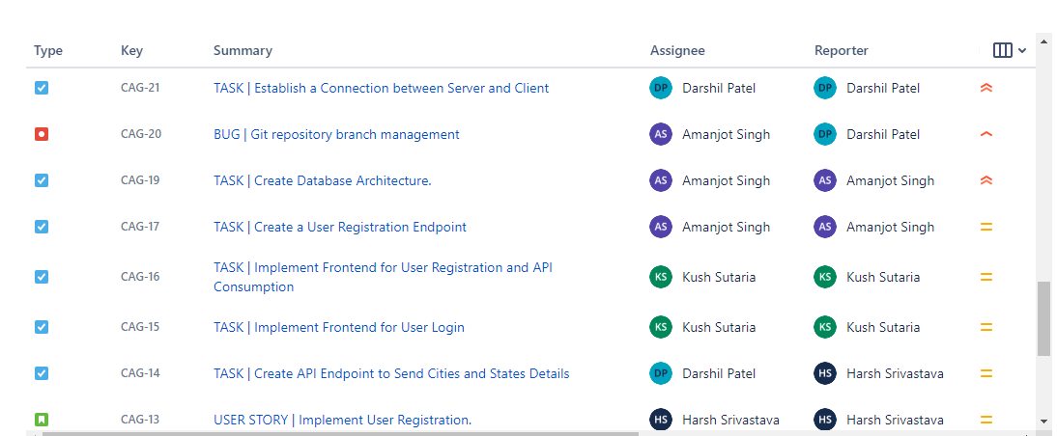
Jira Board

Slide 7
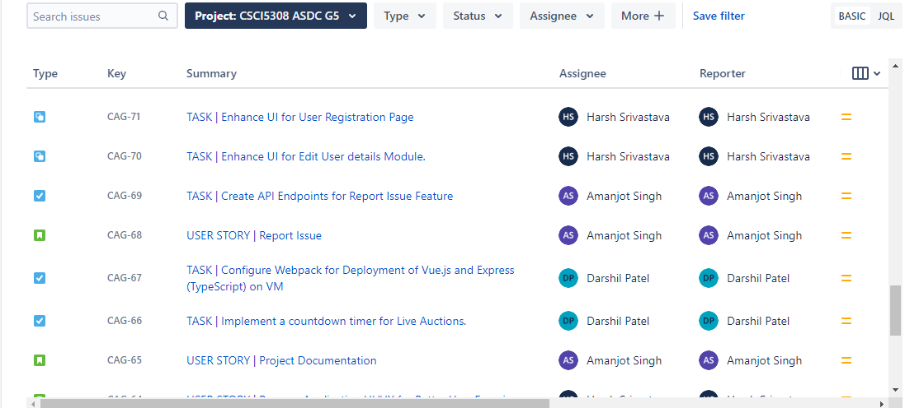

Slide 8
Learning Outcomes
Improved understanding of web development: The project allowed the team to gain a deeper understanding of web development concepts.
Increased proficiency in programming languages and frameworks: hands-on experience in programming languages and frameworks such as Node.js, Express, Vue.js, and SQL databases.
Effective teamwork and collaboration: Developing the project required effective collaboration and communication within the team, leading to improved teamwork and project management skills.
Understanding of project management and development methodologies: The project provided practical experience with project management and development methodologies such as Agile and Scrum, which can be used to manage future projects more efficiently.

Slide 9
DEMO

